Slide 1
SMARTBOX CALIBRATION
FOR GEN II SYSTEMS

Slide 2

Safety First!
Checklist for Personal Protective Equipment:
Gloves, eye wear, etc. are invaluable PPE for preventing pesticide exposure to various body parts.
Read and follow the pesticide label directions as to the type of PPE recommended.
Wear layers of clothing that are loose fitting to provide an air barrier to the body. They should not be so loose that they can be grabbed by moving machinery.
Clean and maintain or replace PPE as needed.
Do not remove gloves to open pesticide containers, adjust equipment or wipe any skin areas.

Slide 3
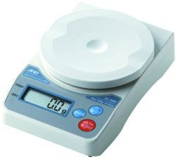
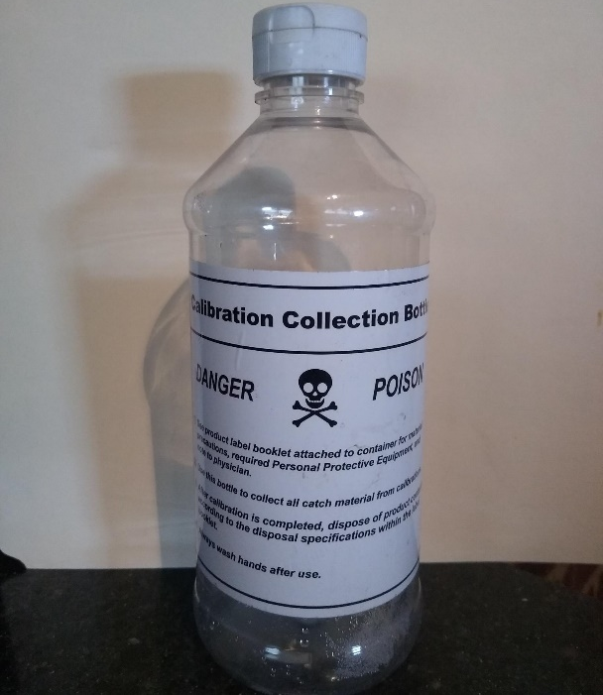
Before Starting Calibration
Equipment
Have all of the required PPE in place.
Have empty calibration bottles attached to the bottom of the meter to catch the metered chemical.
  Catch bottles are available free of charge.
  If you need free catch bottles and scales call 1-888-SMARTBOX, option 1.
Accurate scales are a must.
  Be sure to “zero them out” before weighing bottles.
  Weights are in grams.
  Do not store your scale on it’s side as this will affect accuracy over time.

Slide 4
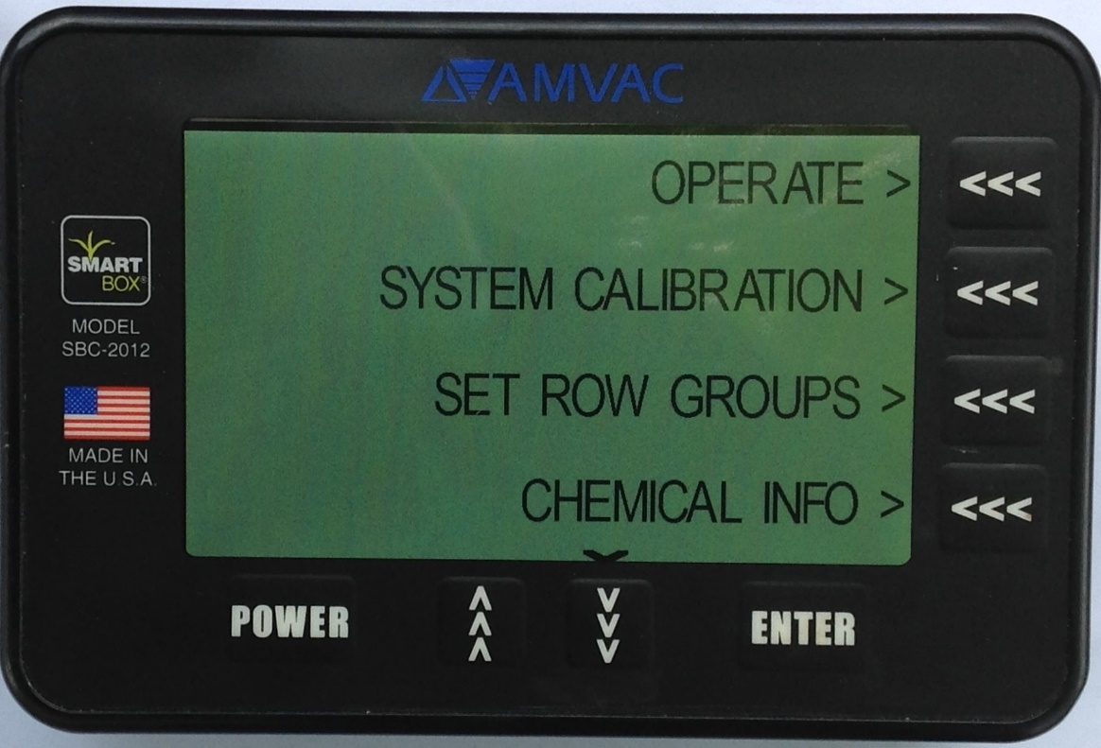
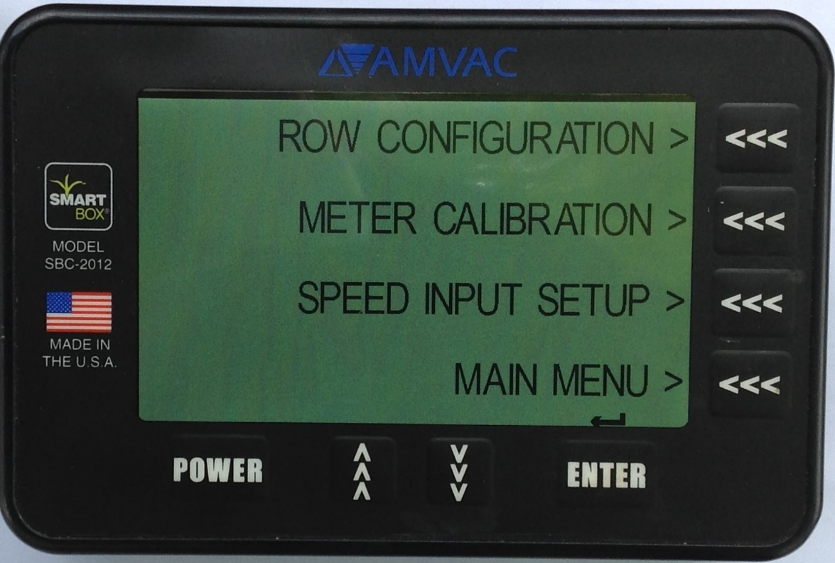
Getting Started
From the main screen, after the boot process is complete, press the SYSTEM CALIBRATION arrow.
Then press the METER CALIBRATION arrow.
A
B

Slide 5
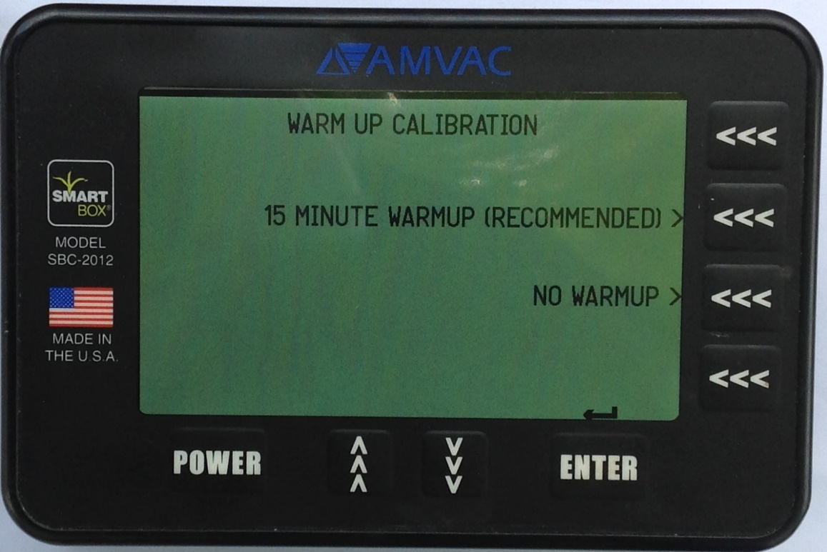
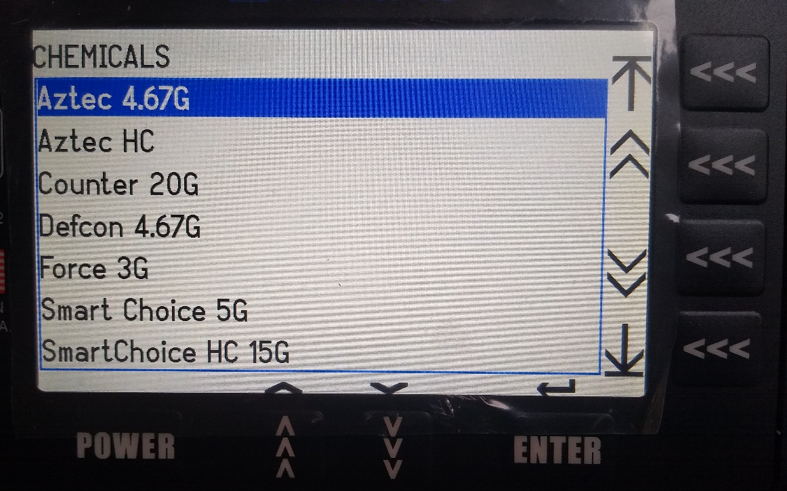
Getting Started
Press the NO WARMUP arrow.
Select the product that will be used from the list on your controller.
C
D

Slide 6
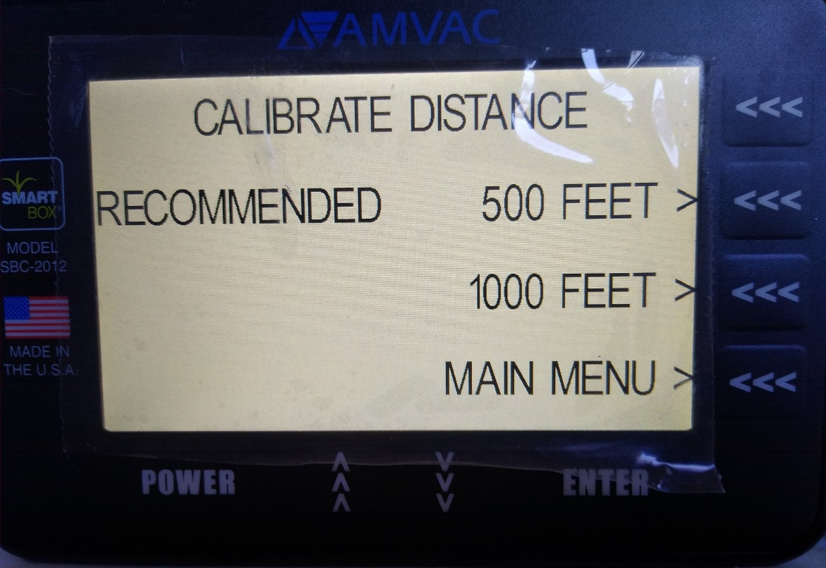
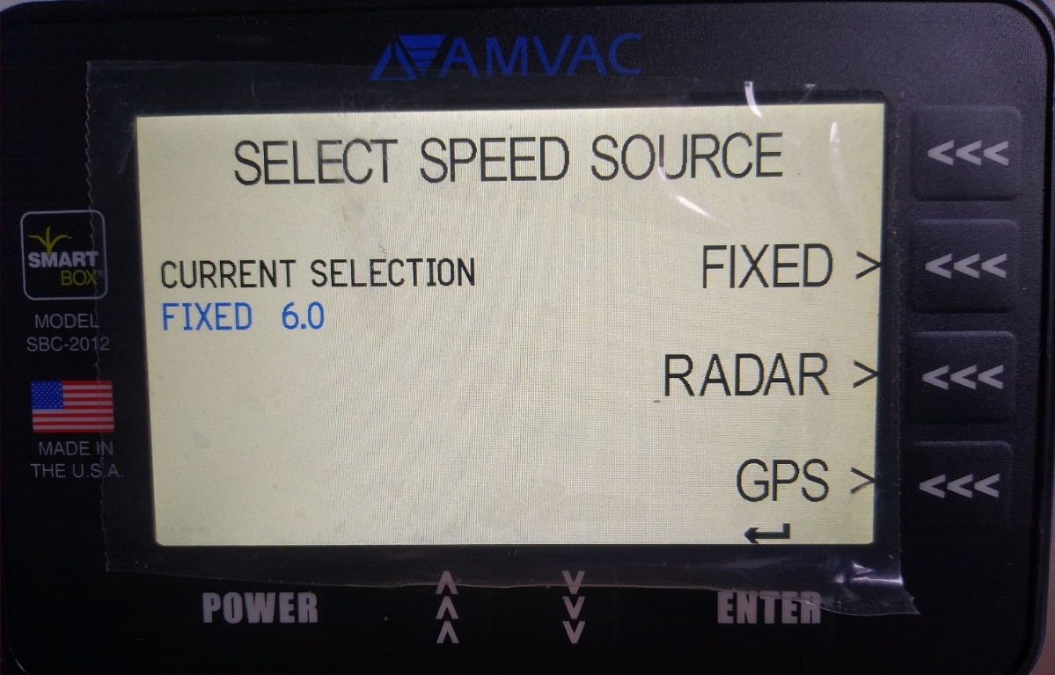
Selecting Speed and Distance
Select the RECOMMENDED Calibration Distance arrow (see chart on next slide for distance).
Lift switch must be FIXED to calibrate.
Remember to turn back to RADAR before planting.
E
F
Note: from the Main Menu
System calibration
Speed Input
FIXED
ENTER-goes back to main menu
G

Slide 7
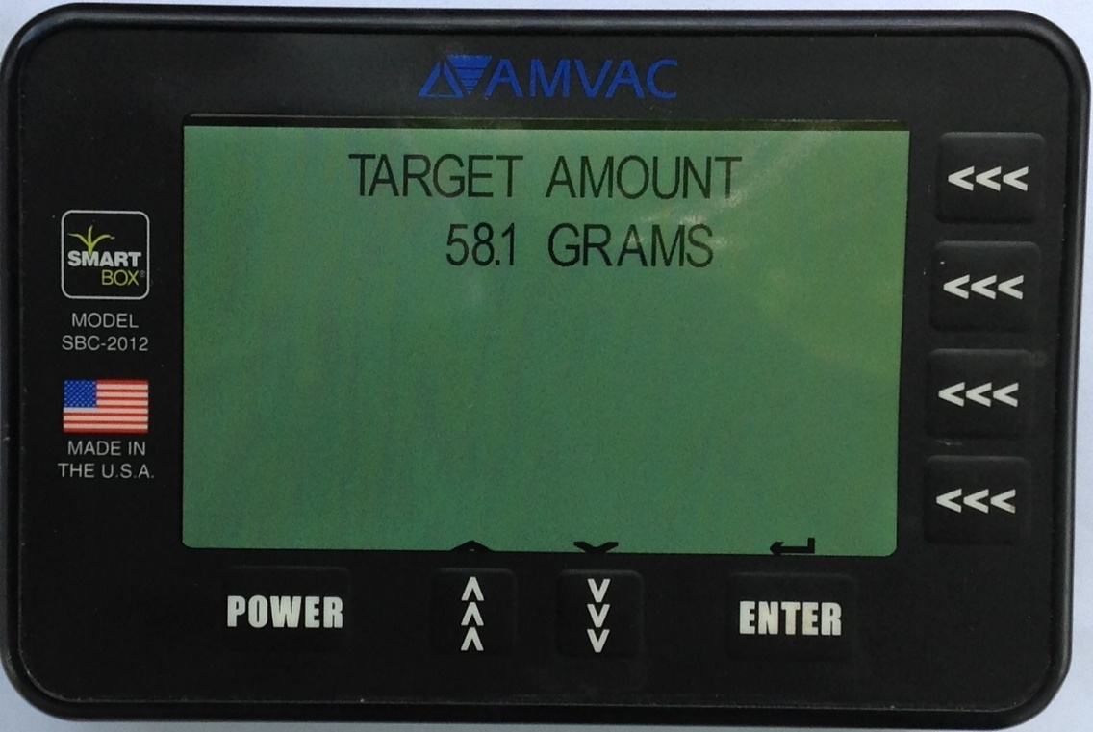
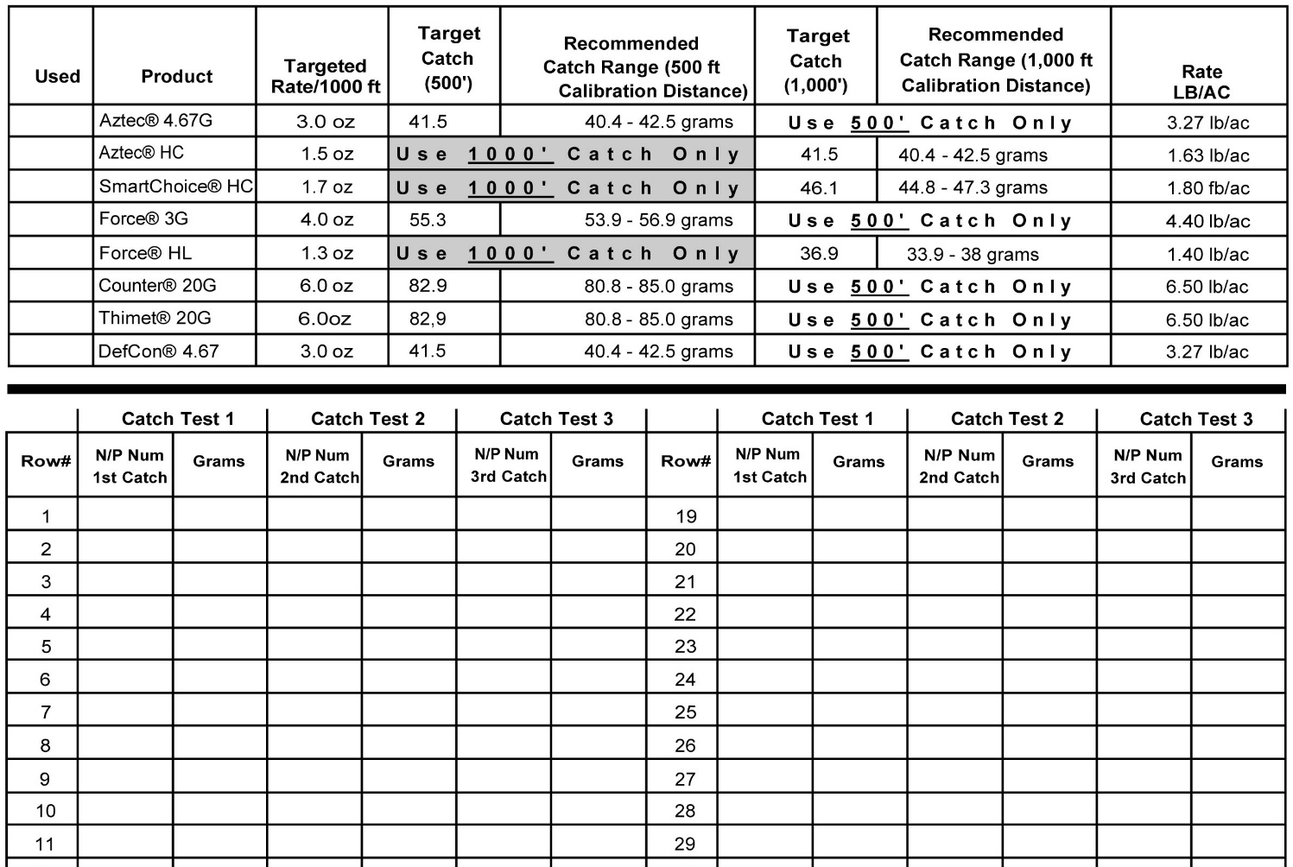
Calibration Target Amounts
Select the TARGET AMOUNT for the product that will be used from the calibration record sheet. Note the amount is in grams.
Always consult the product label for detailed specific instructions on use of product.

Slide 8
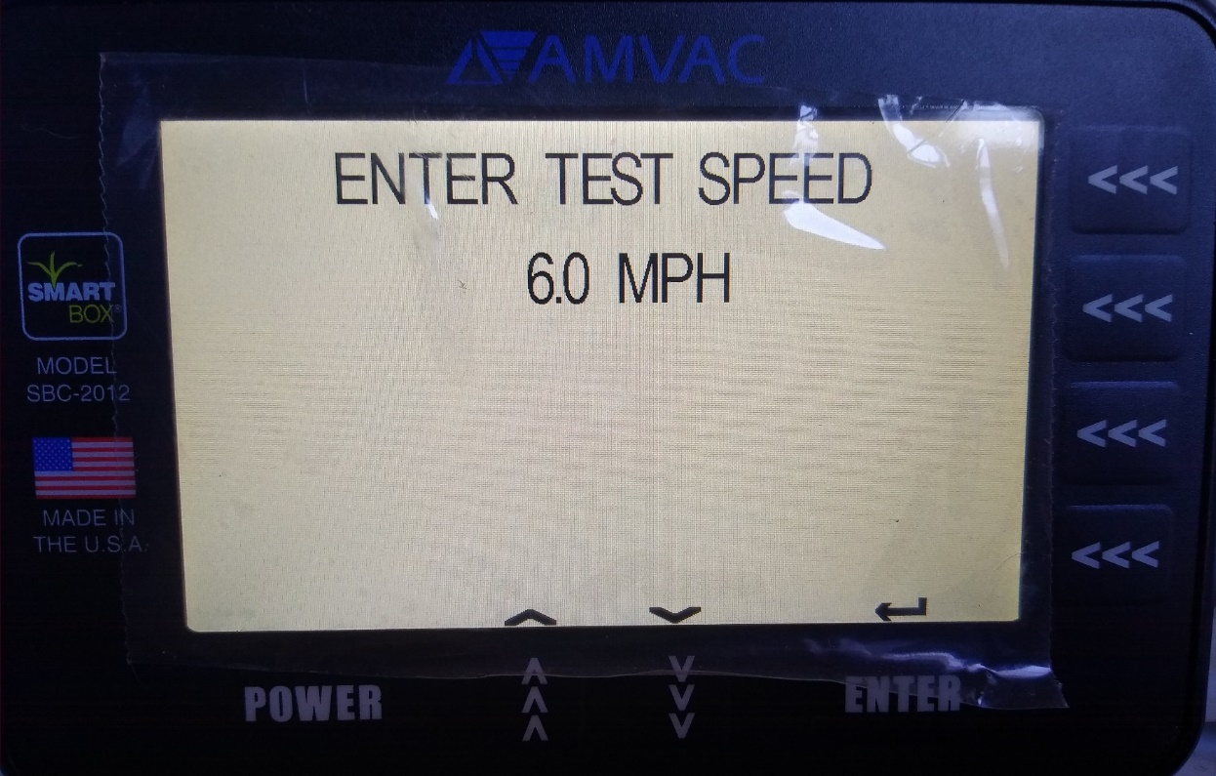
Calibration Target Amounts
Enter the SPEED in mph that the grower will drive during planting.
This input will determine the time needed to simulate the catch distance.
Always consult the product label for detailed specific instructions on use of product.

Slide 9
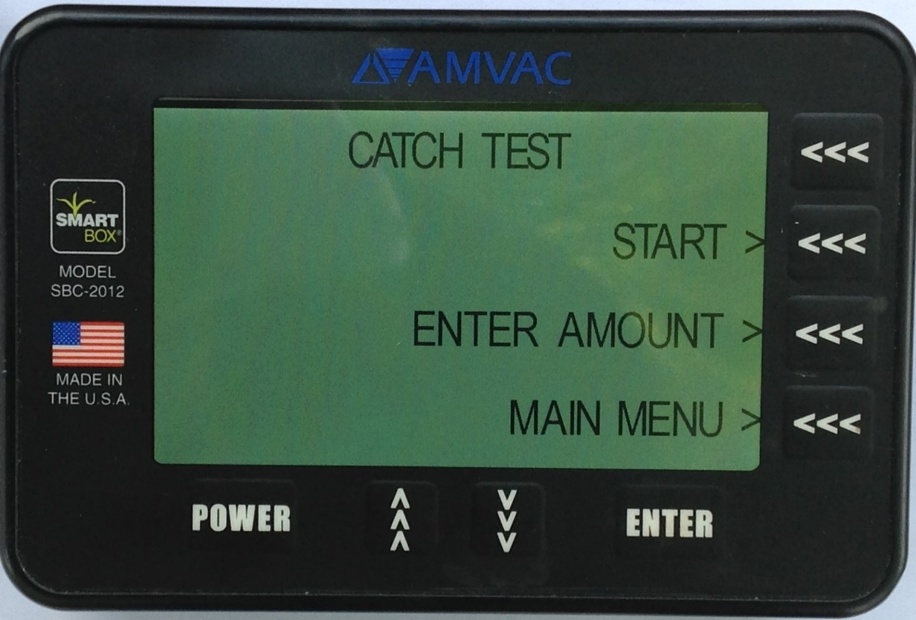
Calibrating
FIRST, place an empty catch bottle on the scale to zero out the bottle weight (tare).
SECOND, be sure to have the tractor running at 1000 to 1500 RPM or have the tractor battery connected to a battery charger to ensure meters and system receives the proper voltage.
Failure to do so will give inaccurate calibrations!
Select Start
A

Slide 10
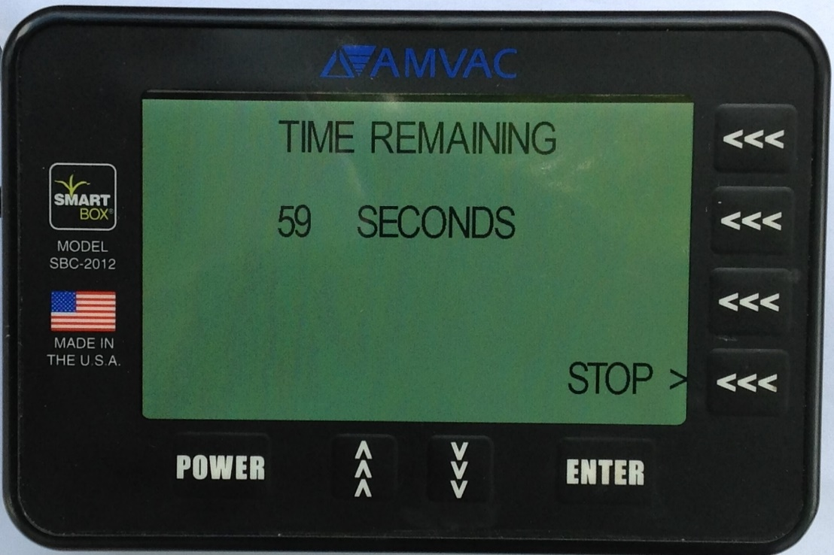
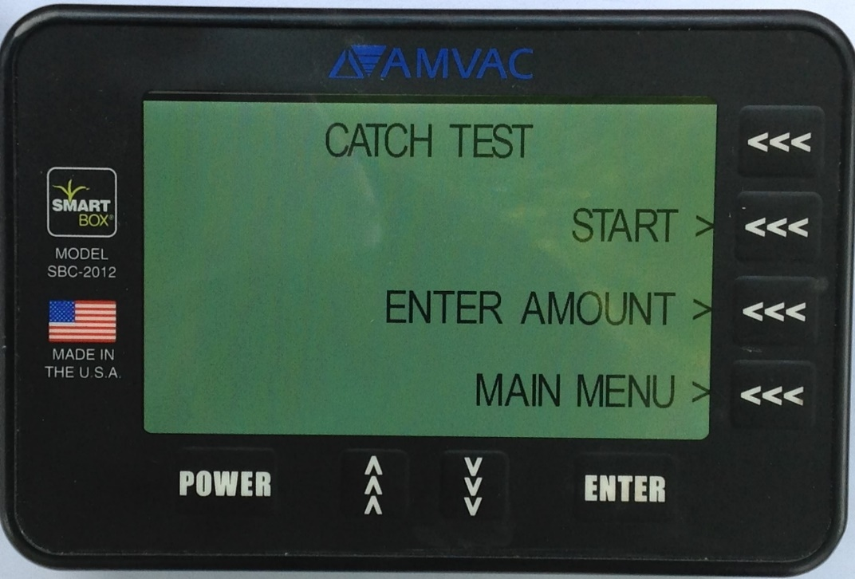
Calibrating
C
B
Timer will countdown to cover the calibration distance selected. Meters will stop dispensing when the simulated distance is covered.
The CATCH TEST screen will appear when the catch is complete.

Slide 11
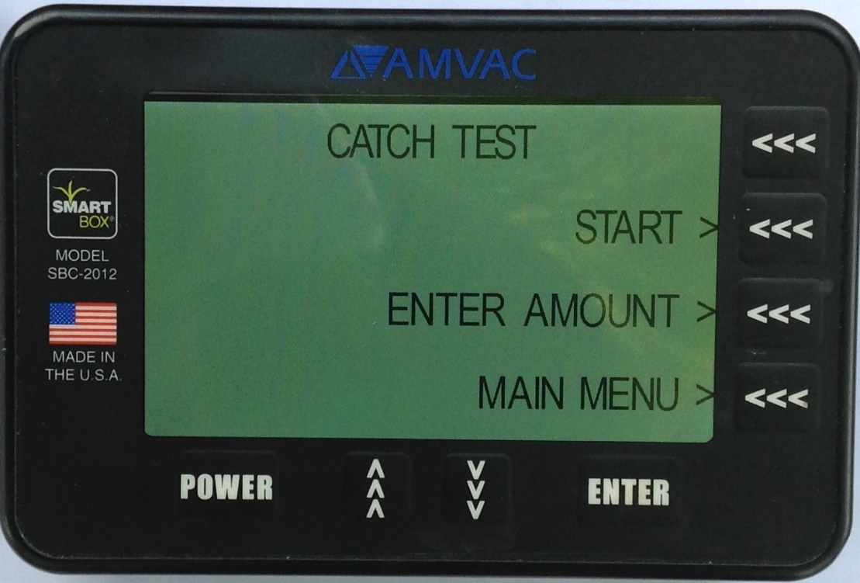
Recording the Calibration
To record the calibration record:
Weigh the bottle with the metered chemical in it to get the amount caught in grams in the bottle.
Proceed back to the tractor to enter the recorded weights caught.
D. Press ENTER AMOUNT to begin entering caught amounts.
D

Slide 12
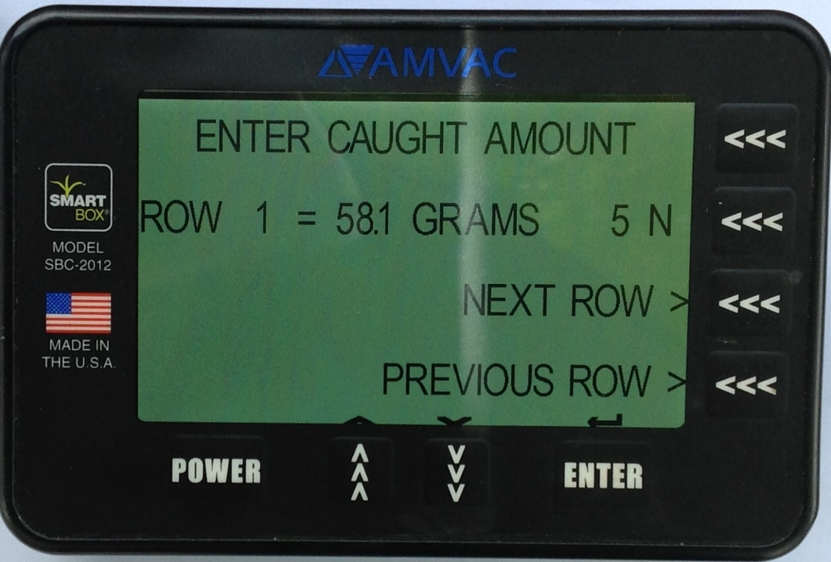
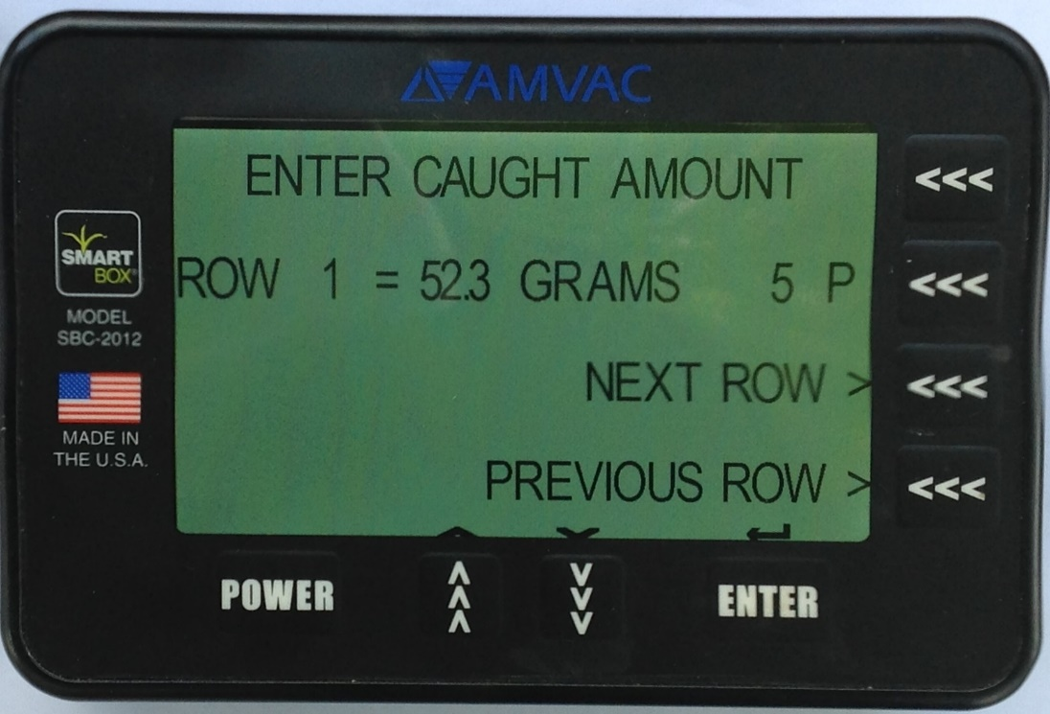
Recording the Calibration
E
G
H
F
This screen displays Row 1,the target amount, and the N/P meter setting number of 5N.
Using the up and down arrows enter the amount caught for row 1. In this example 52.3 grams were caught.
Note that the N/P number has changed from 5N to 5P.
Press NEXT ROW to go to the next row.

Slide 13
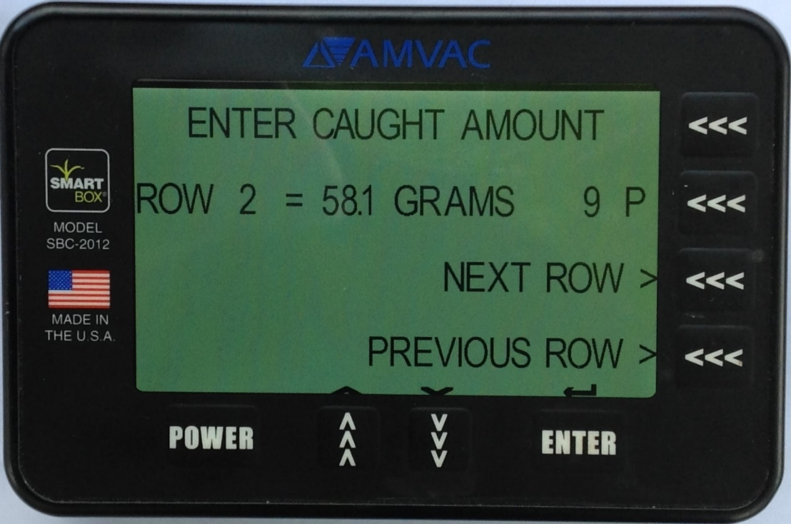
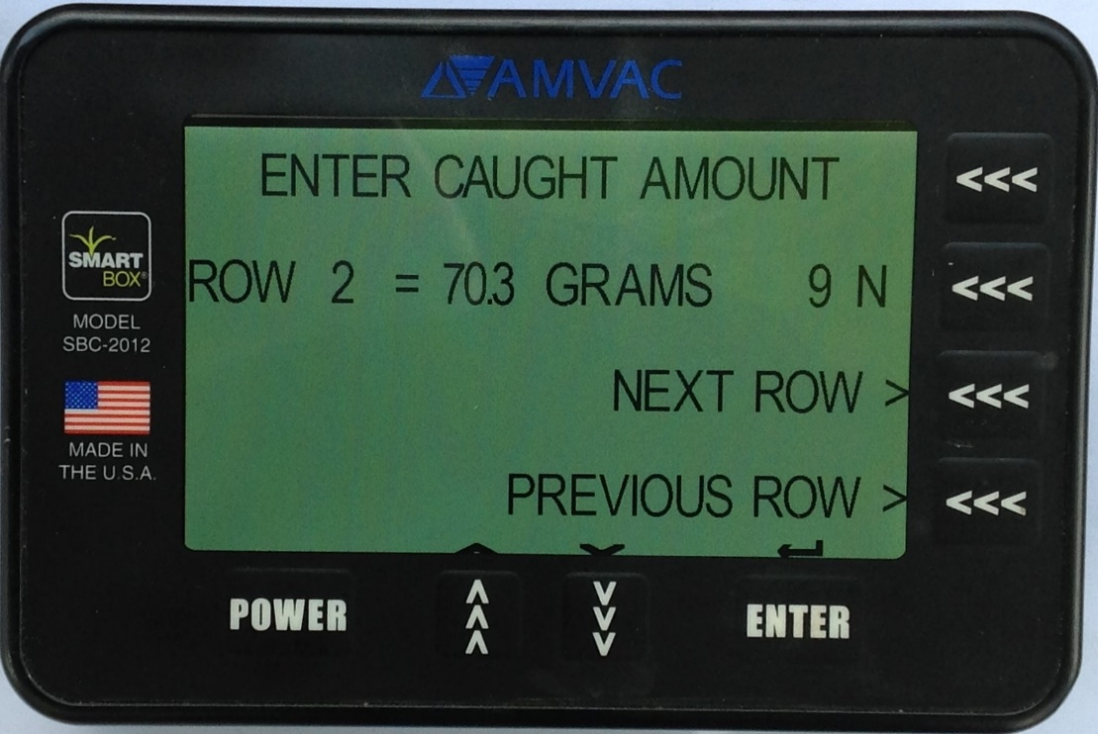
Recording the Calibration
This screen displays Row 2, the target amount, and the N/P meter setting number of 9P.
Using the up and down arrows enter the amount caught for row 2. In this example, 70.3 grams were caught.
I
Note that the N/P number has changed from 9P to 9N.
Press NEXT ROW to go to the next row.
K
L
J

Slide 14
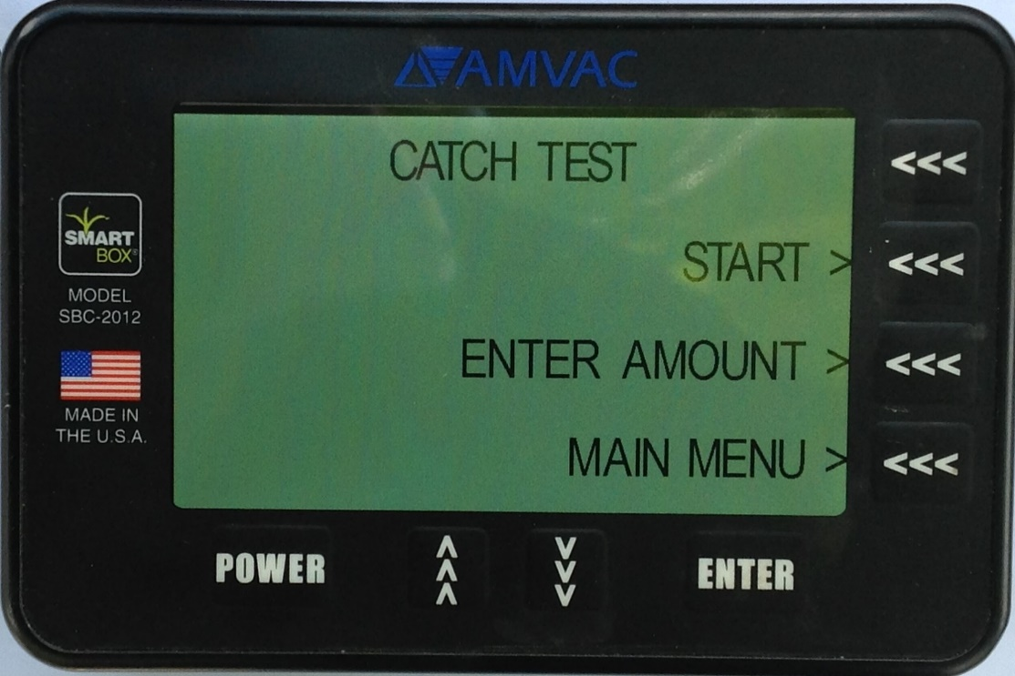
Recording the Calibration
After entering the correct amount caught, screen will change.
Do the same for each row until all rows have catch amounts entered.
After you have completed an entire calibration, it is recommended that you do so once again to ensure your new calibration figures are correct and meters are dispensing accurately.
A
To start a new calibration, reattach empty bottles and press START.

Slide 15
Finishing the Calibration
If all catch amounts were within 5% of the target weight, then press MAIN MENU to SYSTEM CALIBRATION SET screen. If any catch weight was outside of the 5% calibration variance, press YES and conduct another catch test.
Meter calibration is performed to adjust each meter to release an accurate insecticide rate. The meter calibration routine must be performed on all meters at the beginning of each season. In addition, any time a replacement meter is installed, that row must be re-configured and its new meter calibrated. For best results, growers should recalibrate after the first set of transfer containers are empty, when application rates are not accurate and/or if a different chemical will be used.

Slide 16
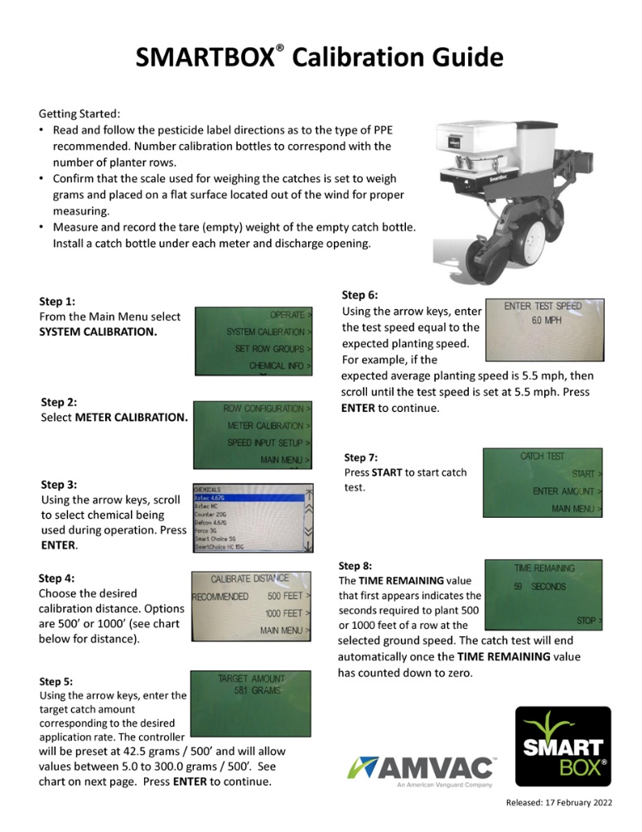
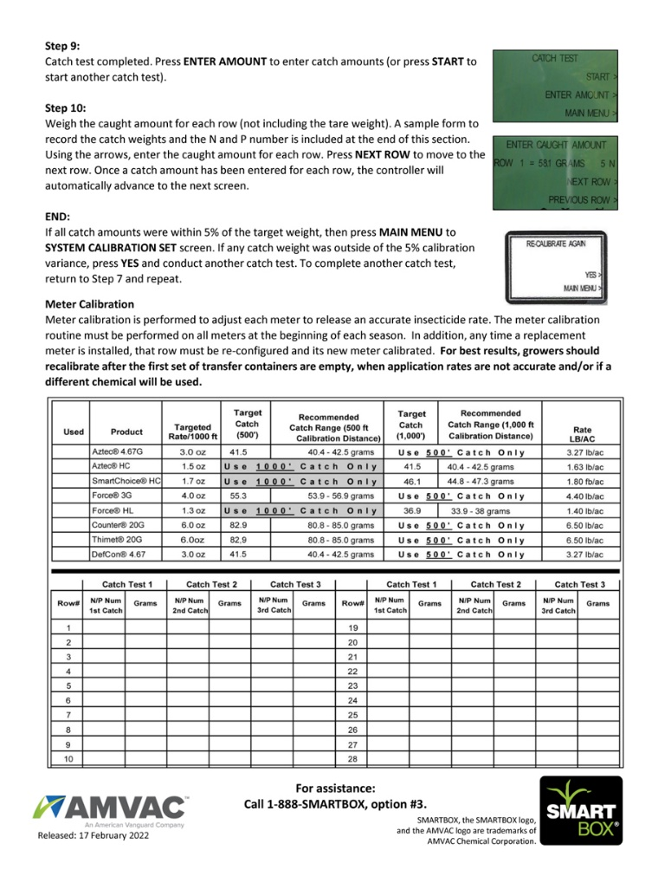
More Information
Printable guides can be found online in PDF format.

Slide 17
Disclaimer
Any discrepancy between intended use-rates and actual use-rates is the responsibility of the operator during operation.
Because SmartBox equipment is subject to normal rigors of planting during use, it is important to ensure product usage is monitored and if necessary, adjusted during the planting season. It is recommended that each time the operator stops to install full SmartBox product-containers, the operator should determine that the actual product use-rate is consistent with the intended product use-rate. If actual use-rates vary from intended use-rates, it is the operator’s responsibility to identify and correct the source of the discrepancy.
If you need technical assistance with the operation of your SmartBox system,
call 1-888-SMARTBOX, Option #3 for free assistance.
SMARTBOX, the SMARTBOX logo, and the AMVAC logo are trademarks of AMVAC Chemical Corporation.

